Slide 1
ListView,
Spinner,

Slide 2
List View
Android ListView is a view which groups several items and display them in vertical scrollable list.
The list items are automatically inserted to the list using an Adapter that pulls content from a source such as an array or database.

Slide 3
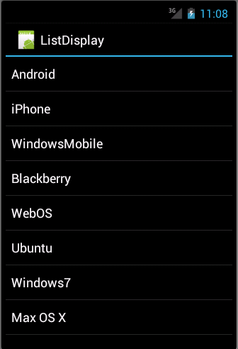

Slide 4
ListView Attributes
Sr.No | Attribute & Description
1 | android:id This is the ID which uniquely identifies the layout.
2 | android:divider This is drawable or colour to draw between list items.
3 | android:dividerHeight This specifies height of the divider. This could be in px, dp, sp, in, or mm.
4 | android:entries Specifies the reference to an array resource that will populate the ListView.
5 | android:footerDividersEnabled When set to false, the ListView will not draw the divider before each footer view. The default value is true.
6 | android:headerDividersEnabled When set to false, the ListView will not draw the divider after each header view. The default value is true.

Slide 5
Adapter
An adapter actually bridges between UI components and the data source that fill data into UI Component.
Adapter holds the data and send the data to adapter view, the view can takes the data from adapter view and shows the data on different views like as spinner, list view, grid view etc.
The ListView and GridView are subclasses of AdapterView and they can be populated by binding them to an Adapter, which retrieves data from an external source and creates a View that represents each data entry.
Android provides several subclasses of Adapter that are useful for retrieving different kinds of data and building views for an AdapterView ( i.e. ListView or GridView).
The common adapters are
ArrayAdapter,
Base Adapter
CursorAdapter,
SimpleCursorAdapter,
SpinnerAdapter
WrapperListAdapter.

Slide 6
ArrayAdapter
This adapter is used when the data source is an array.
By default, ArrayAdapter creates a view for each array item by calling toString() on each item and placing the contents in a TextView.
Consider an array of strings that needs to be displayed in a ListView, initialize a new ArrayAdapter using a constructor to specify the layout for each string and the string array −
ArrayAdapter adapter = new ArrayAdapter<String>(this,R.layout.ListView,StringArray);
Arguments for this constructor
this is the application context.
layout defined in XML file and having TextView for each string in the array.
An array of strings which will be populated in the text view.
Call setAdapter() on your ListView object as follows −
ListView listView = (ListView) findViewById(R.id.listview); listView.setAdapter(adapter);
Define list view under res/layout directory in an XML file.

Slide 7
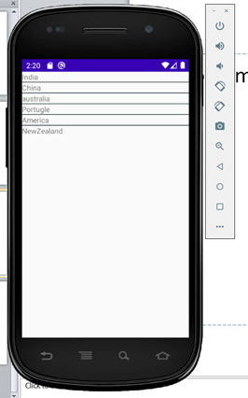
Example
Program code

Slide 8
Spinner
Android Spinner is a view similar to the dropdown list which is used to select one option from the list of options.
It provides an easy way to select one item from the list of items and it shows a dropdown list of all values when we click on it.
The default value of the android spinner will be the currently selected value and by using Adapter we can easily bind the items to the spinner objects.
Generally, we populate our Spinner control with a list of items by using an ArrayAdapter .

Slide 9
Different Attributes for Spinner Widget
XML attributes | Description
android:id | Used to specify the id of the view.
android:textAlignment | Used to the text alignment in the dropdown list.
android:background | Used to set the background of the view.
android:padding | Used to set the padding of the view.
android:visibility | Used to set the visibility of the view.
android:gravity | Used to specify the gravity of the view like center, top, bottom, etc

